Slide 1



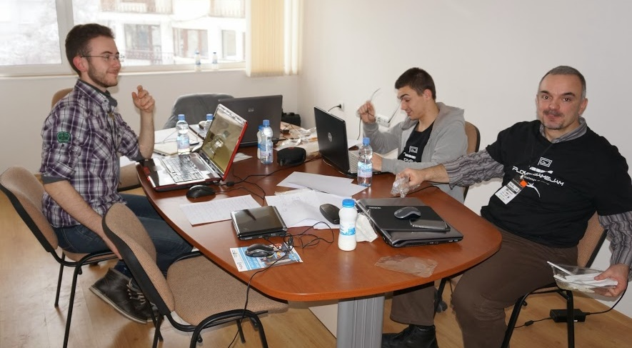
Team Work and Personal Skills
Course Introduction
SoftUni Team
Technical Trainers
Software University
http://softuni.bg

Slide 2



Table of Contents
Course Objectives
Course Program
Trainers Team
Assessment
Learning Resources

Slide 3









SoftUni Diamond Partners

Slide 4



Course Objectives & Program
What Topics Shall We Cover?

Slide 5

The Course Objectives
Team Working and Personal Skills course goals
Get along in preset teams of 3-7 people
Learn to enjoy collaborating with others
Learn to work on real-world practical projects
Develop a culture of open sharing of knowledge
Help SoftUni to grow and operate its free trainings
Promote the free trainings / assist in teaching

Slide 6

Course Benefits
Benefits from the course
Adopt the open knowledge culture
Build your own blog
Your blog is more than online CV!
Build your own public developer profile (at GitHub / Google Code / CodePlex)
Get team working experience
On real-world projects, in real teams
Learn how to learn: mind mapping, speed reading, etc.

Slide 7
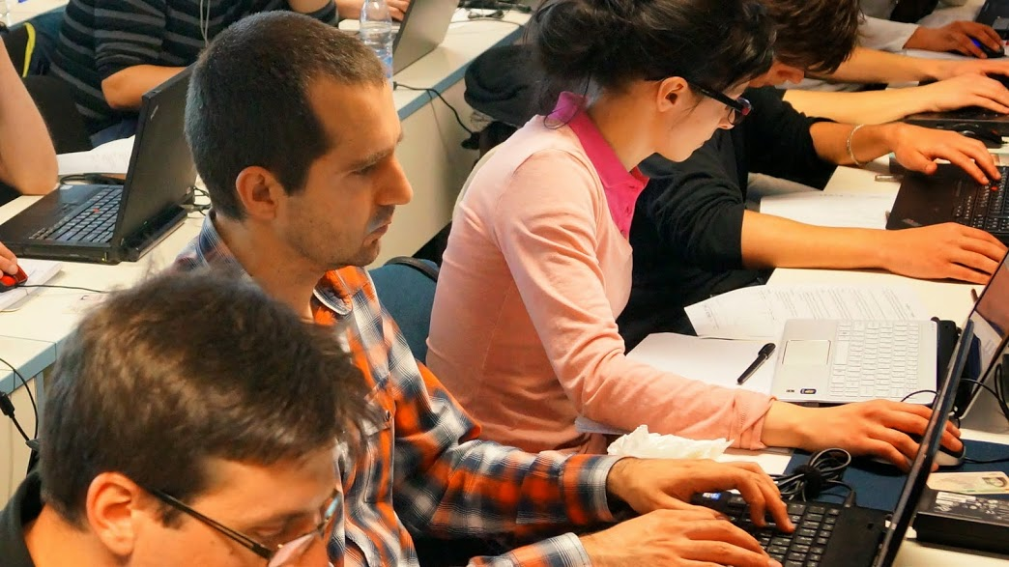

Course Program
Course Intro
Source Control Systems: Git, SVN, TFS
Project Tracking Tools: Trello, BaseCamp, …
Start Your Own Blog
Teambuilding
Writing a CV and Cover Letter
Finding and Successfully Going Through Interview
Mind Mapping
Speed Reading and Efficient Study Techniques

Slide 8
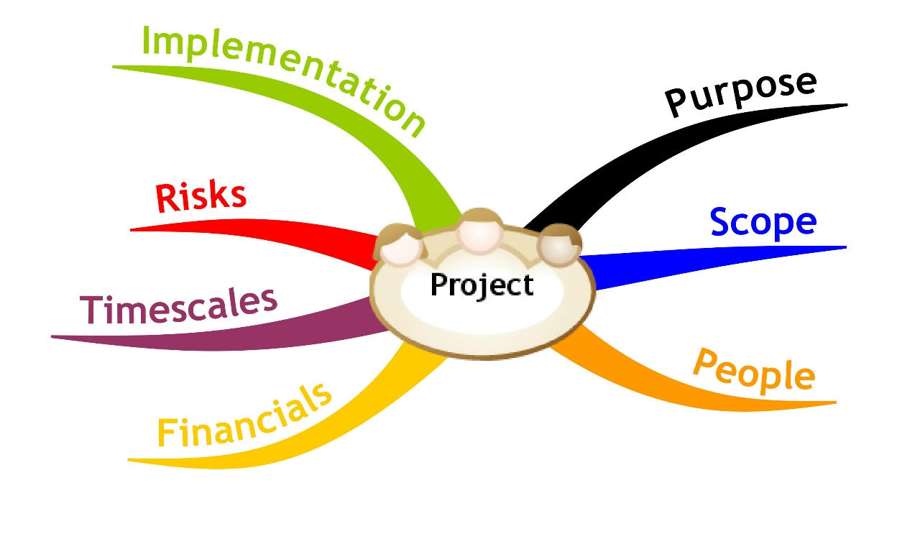
Team Work Projects @ SoftUni
Application Process, Team Work Process, Examples

Slide 9

Team Work Projects: The Process
The process for working on the team projects:
Students sign-up for a team work
The system splits the students in teams
The trainers assign a team work project
The students find each other and begin work
Students work on their projects
Assign tasks, collaborate, communicate, perform meetings, write code and documents, merge the results, etc.
Perform a public defense (presentation)
Asses each team member and give feedback

Slide 10

Sample Team Work Projects
Write a Wikipedia article about programming
E.g. "sorting algorithms", "GitHub", "C#"
Write a console-based game
E.g. Snake / Tetris / Minesweeper / Falling Rocks
Create a web site
E.g. a site for fun stories / fun images
Create a JavaScript web-based game
E.g. Tetris / Falling Rocks / Xonix

Slide 11

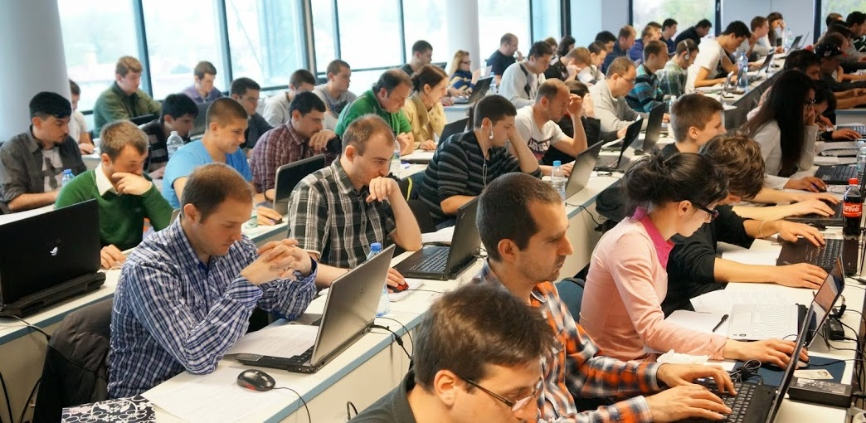

Assessment
Assessment Criteria

Slide 12


Assessment
Homework – 50%
Teamwork Project – 50%
Bonuses – up to 10%
Presence in class – 5% (onsite students only)

Slide 13








Resources
What We Need in Addition to This Course Content?

Slide 14
Course Web Site & Forums
Register for the "SoftUni Forum":
Discuss the course exercises with your colleagues
Find solutions and assistance for the exercises
Share source work / discuss ideas
The course official web site:
https://softuni.bg/forum/
https://softuni.bg/courses/teamwork-and-personal-skills/

Slide 15
TWPS – Course Introduction
https://softuni.bg/courses/teamwork-and-personal-skills/

Slide 16
License
This course (slides, examples, demos, videos, homework, etc.) is licensed under the "Creative Commons Attribution-NonCommercial-ShareAlike 4.0 International" license
Attribution: this work may contain portions from
"Knowledge Sharing and Team Working" course by Telerik Academy under CC-BY-NC-SA license

Slide 17





Free Trainings @ Software University
Software University Foundation – softuni.org
Software University – High-Quality Education, Profession and Job for Software Developers
softuni.bg
Software University @ Facebook
facebook.com/SoftwareUniversity
Software University @ YouTube
youtube.com/SoftwareUniversity
Software University Forums – forum.softuni.bg

